Slide 1
PBL Presentation Earth & Space

Slide 2
Wondering & Questioning
Check out the resources in the next slide, as well as the materials in your PBL tub to stir up WONDER. Use your STUDENT WORKBOOK to keep track of your thinking.

Slide 3
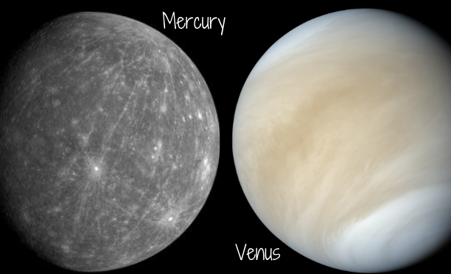
See the photographs of planets below. What do you wonder?

Slide 4
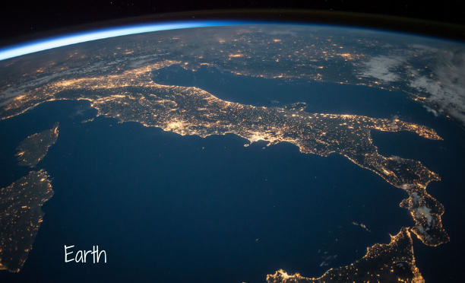
See the photographs of planets below. What do you wonder?

Slide 5
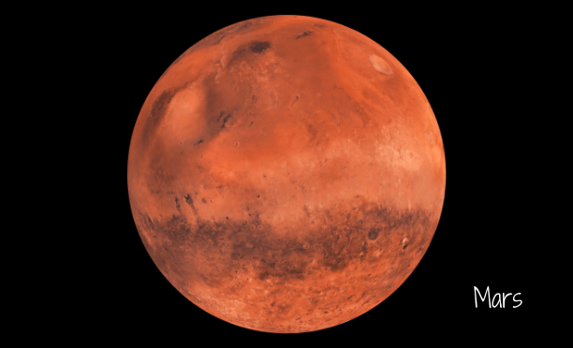
See the photographs of planets below. What do you wonder?

Slide 6
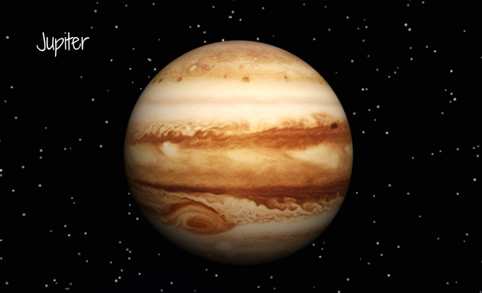
See the photographs of planets below. What do you wonder?

Slide 7
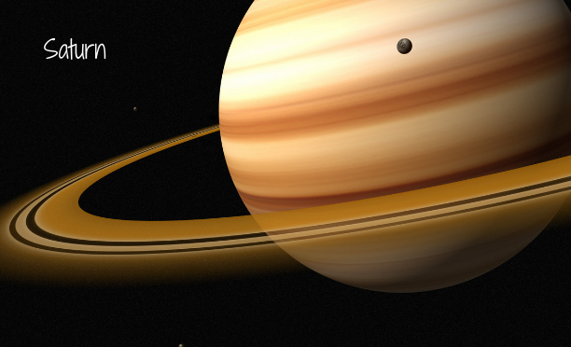
See the photographs of planets below. What do you wonder?

Slide 8
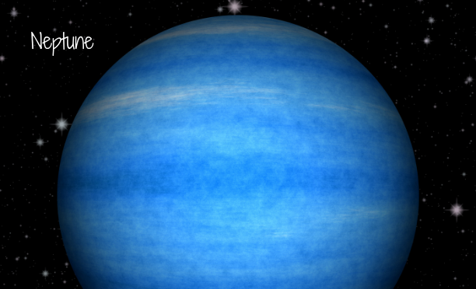
See the photographs of planets below. What do you wonder?

Slide 9
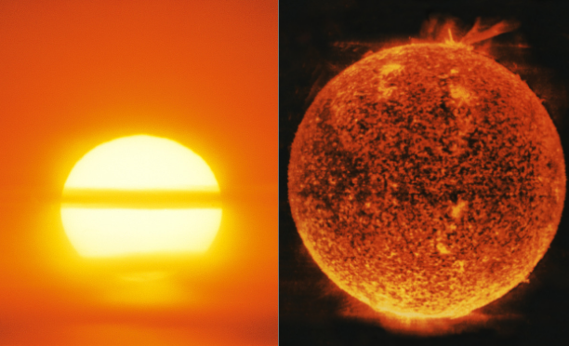
See the photographs of the sun below. What do you wonder?

Slide 10
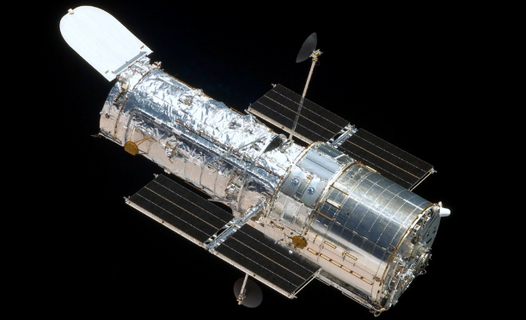
See the photograph of the Hubble Telescope below. What do you wonder?

Slide 11
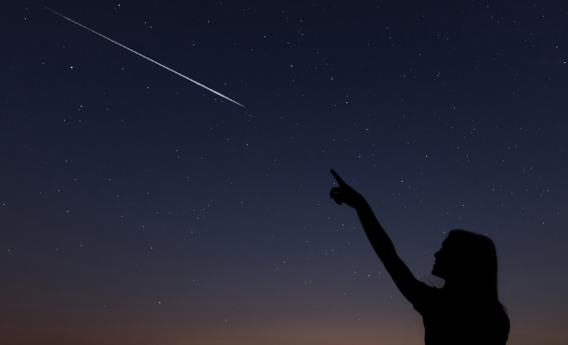
See the photograph of a shooting star below. What do you wonder?

Slide 12
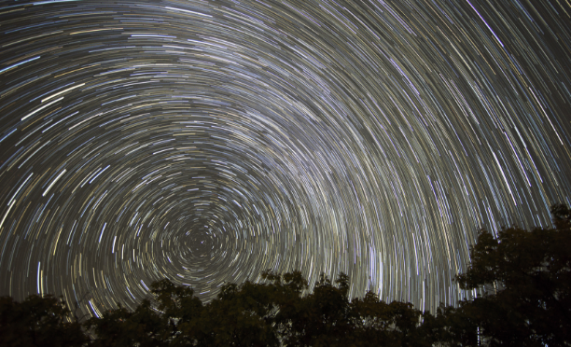
See the time lapse photo of stars below. What do you wonder?

Slide 13
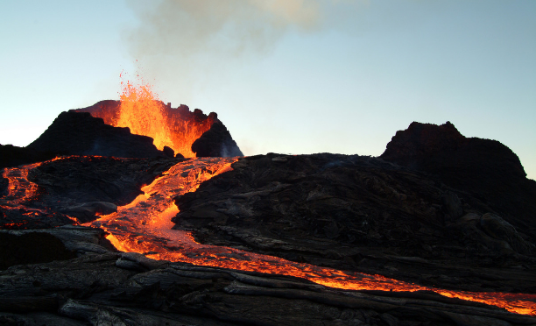
See the photograph of an erupted volcano below. What do you wonder?

Slide 14
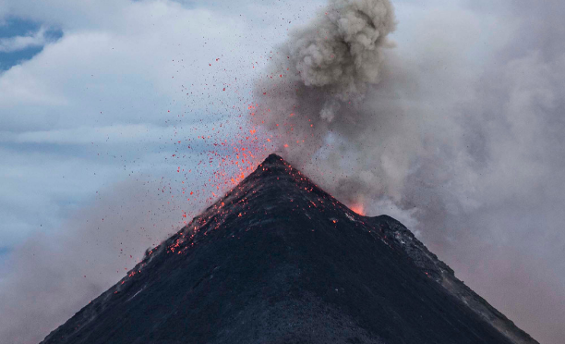
See the photograph of an erupted volcano below. What do you wonder?

Slide 15
Questions to consider while exploring:
How do you think the other planets compare to Earth in size?
Which planet do you think is the hottest? Coldest?
Do you think there could be life on other planets?
What would it be like to travel to outer space?
What would it be like to walk on the moon?
What is your favorite planet? Why?
What do you think stars are made of?
What exactly is the sun, and how big is it?
Why can Earth sustain life?

Slide 16
Week 1 Day, Night, & Sun
Developing Background Knowledge

Slide 17
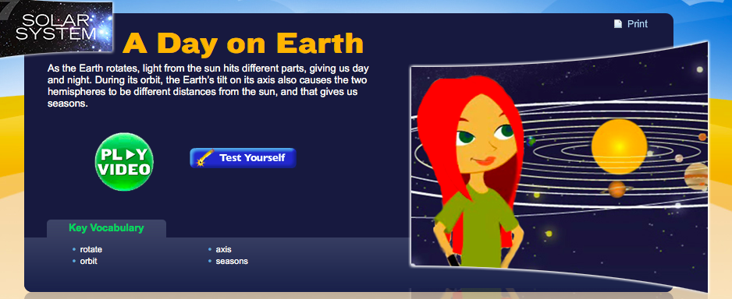
What causes DAY & NIGHT ON EARTH? Click on the video below to learn more.

Slide 18
What causes DAY & NIGHT ON EARTH?
On Earth, the change between DAY & NIGHT is caused by the Earth’s rotation on its axis. A full day is 24 hours, meaning it takes about 24 hours for Earth to complete a rotation on its axis. The amount of DAYLIGHT changes because the earth sits on a tilt at about 23.5 degrees. Due to this, some spots on earth may have more daylight than others. As the earth moves around the sun, seasons are established which also effects the length of daylight hours. It takes Earth one year to complete a rotation around the sun.

Slide 19
Check out these photo examples of DAY & NIGHT. What do you wonder?

Slide 20
What else are you wondering about this week? Keep track of your wonders and ideas in your STUDENT WORKBOOK.

Slide 21
Week 2 The Moon & Tides
Developing Background Knowledge

Slide 22
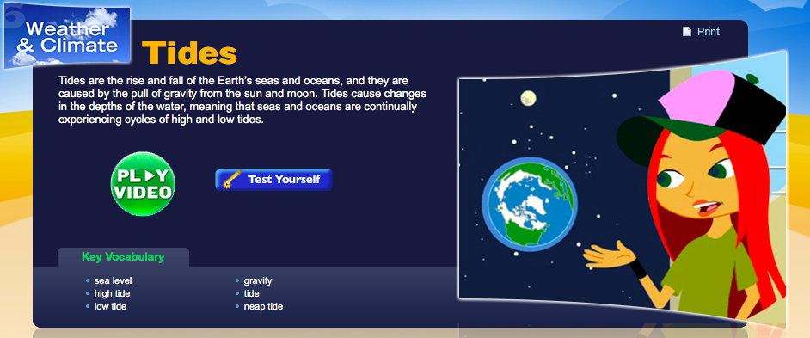
What is the relationship between THE MOON & TIDES? Click on the video below to learn more.

Slide 23
What is the MOON & TIDES RELATIONSHIP?
The MOON uses gravity to effect the ocean’s tide. TIDE is the rise and fall of the ocean’s water level over a period of time. This rise and fall of the ocean is directly related to the moons rotation around the earth. As the moon orbits around the earth, it’s gravitational pull causes the ocean to bulge and recede.
HIGH TIDE occurs when the ocean is directly facing the moon. LOW TIDE occurs when the waters recede between each high tide. High and low tide both occur twice a day.

Slide 24
Check out these photo examples of the MOON & TIDES. What do you wonder?

Slide 25
What else are you wondering about this week? Keep track of your wonders and ideas in your STUDENT WORKBOOK.

Slide 26
Week 3 Layers of the Earth
Developing Background Knowledge

Slide 27
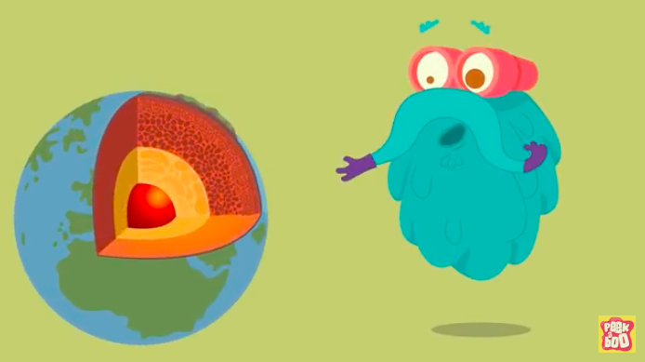
What are the LAYERS OF THE EARTH? Click on the video below to learn more.

Slide 28
What are the LAYERS OF THE EARTH?
EARTH’S LAYERS can be divided into three main layers: the crust, the mantle, and the core. These main layers can be divided further into the continental and oceanic crusts, the upper and lower mantle, and the inner and outer core.

Slide 29
Learn more information about the LAYERS OF THE EARTH from these excerpts from National Geographic for Kids Online.
Inner Core
Temperature: 5,000°C – 6,000°C State: Solid Composition: iron and nickel
The Earth’s inner core is a huge metal ball, 2,500km wide. Made mainly of iron, the temperature of the ball is 5,000°C to 6,000°C – that’s up to 6,000 times hotter than our atmosphere and scorching enough to make metal melt! The metal at the inner core stays solid because of the incredible pressure surrounding it.
Outer Core
Temperature: 4,000°C – 6,000°C State: Liquid Composition: iron, nickel, sulphur and oxygen
This liquid layer of iron and nickel is 5,150km deep. The outer core flows around the centre of the Earth, and the movement of the metals creates our planet’s magnetic field.

Slide 30
Learn more information about the LAYERS OF THE EARTH from these excerpts from National Geographic for Kids Online. (cont.)
Lower Mantle
Temperature: 3,000°C State: solid Composition: iron, oxygen, silicon, magnesium and aluminium
The lower mantle is found between 670km and 2,890km below the surface, and is made from solid rock. The rock is hot enough to melt, but is solid because of the pressure pushing down on it.
Upper Mantle
Temperature: 1,400°C – 3,000°C State: liquid / solid Composition: iron, oxygen, silicon, magnesium and aluminium
This layer is up to 670km below the Earth’s surface. The lower part of the upper mantle is made from both solid and melted rock (liquid), while the rock in the upper region is stiffer, because it’s cooler.

Slide 31
Learn more information about the LAYERS OF THE EARTH from these excerpts from National Geographic for Kids Online. (cont.)
Crust
Temperature: Around 22°C State: Solid Composition: Oceanic crust made up of iron, oxygen, silicon, magnesium and aluminium. Continental crust made up of granite, sedimentary rocks and metamorphic rocks.
The Earth’s surface is covered by its thinnest layer, the crust. Land is made of continental crust, which is 8km to 70km thick and made mostly from a rock called granite. The layer beneath the ocean bed is made of oceanic crust, which is about 8km thick and made mainly from a rock called basalt.

Slide 32
Check out this illustration of the EARTH’S CRUST. What do you wonder about?

Slide 33
Check out these photos of the LAYERS OF THE EARTH. What do you wonder about?

Slide 34
What else are you wondering about this week? Keep track of your wonders and ideas in your STUDENT WORKBOOK.

Slide 35
Week 4 Earthquakes & Volcanoes
Developing background knowledge

Slide 36
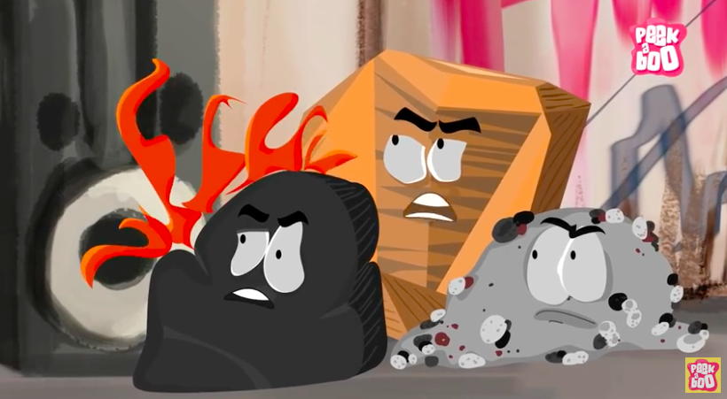
What are the different types of ROCKS? Click on the video below to learn more.

Slide 37
What are the different types of ROCKS? Read this excerpt from an ONLINE SOURCE to learn more.
The three main types, or classes, of rock are sedimentary, metamorphic, and igneous and the differences among them have to do with how they are formed. Sedimentary Sedimentary rocks are formed from particles of sand, shells, pebbles, and other fragments of material. Together, all these particles are called sediment. Gradually, the sediment accumulates in layers and over a long period of time hardens into rock. Generally, sedimentary rock is fairly soft and may break apart or crumble easily. You can often see sand, pebbles, or stones in the rock, and it is usually the only type that contains fossils. Examples of this rock type include conglomerate and limestone.

Slide 38
What are the different types of ROCKS? Read this excerpt from an ONLINE SOURCE to learn more. (cont.)
Metamorphic Metamorphic rocks are formed under the surface of the earth from the metamorphosis (change) that occurs due to intense heat and pressure (squeezing). The rocks that result from these processes often have ribbonlike layers and may have shiny crystals, formed by minerals growing slowly over time, on their surface. Examples of this rock type include gneiss and marble.

Slide 39
What are the different types of ROCKS? Read this excerpt from an ONLINE SOURCE to learn more. (cont.)
Igneous Igneous rocks are formed when magma (molten rock deep within the earth) cools and hardens. Sometimes the magma cools inside the earth, and other times it erupts onto the surface from volcanoes (in this case, it is called lava). When lava cools very quickly, no crystals form and the rock looks shiny and glasslike. Sometimes gas bubbles are trapped in the rock during the cooling process, leaving tiny holes and spaces in the rock. Examples of this rock type include basalt and obsidian.

Slide 40
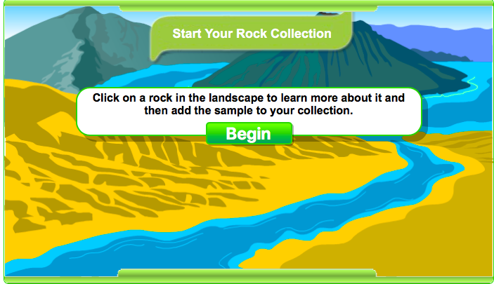
What are the different types of ROCKS? Learn more by exploring this interactive rock collection activity online. Click below.

Slide 41
Check out these photos of VARIOUS ROCKS. What do you wonder about?

Slide 42
What causes EARTHQUAKES? Click on the video below to learn more.

Slide 43
What causes EARTHQUAKES?
An EARTHQUAKE is caused by the movement of tectonic plates. Earth’s crust is made up of tectonic plates that sit atop the earth’s slowly flowing mantle. The tectonic plates bump and slide within the earth’s crust very slowly. When these tectonic plates bump into one another, an earthquake can occur.

Slide 44
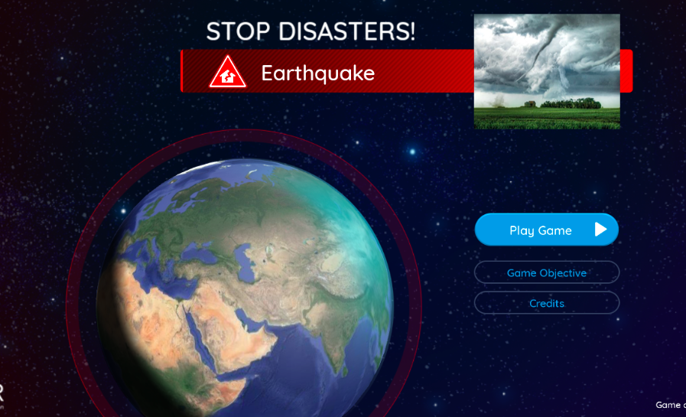
How to stay safe during EARTHQUAKES? Explore this online activity to learn more.

Slide 45
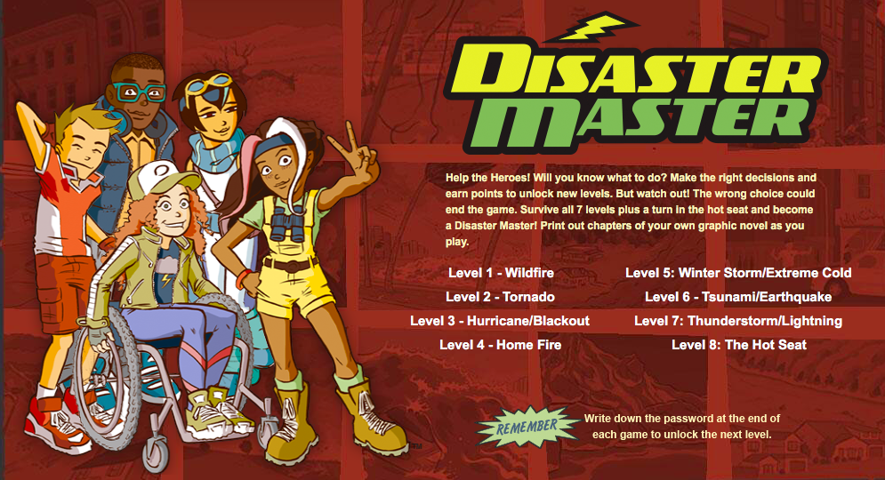
How to stay safe during NATURAL DISASTER? Explore this online activity to learn more.

Slide 46
Check out these photos of EARTHQUAKES. What do you wonder about?

Slide 47
What causes VOLCANOES? Click on the video below to learn more.

Slide 48
What causes VOLCANOES?
A VOLCANOE is a vent in the earth's crust that allows rock fragments, magma (lava), hot vapor and gases to be erupted. Volcanoes are formed when tectonic plates within the earth’s crust push into each other.
CLICK HERE for more resources.

Slide 49
Check out these photos of VOLCANOES. What do you wonder about?

Slide 50
What else are you wondering about this week? Keep track of your wonders and ideas in your STUDENT WORKBOOK.

Slide 51
Week 5 Stars
Developing background knowledge.

Slide 52
What are CONSTELLATIONS? Click on the video below to learn more.

Slide 53
What are CONSTELLATIONS? Click on the video below to learn more.

Slide 54
What are CONSTELLATIONS?
CONSTELLATIONS is are groups of stars that form a recognizable shape or pattern.
CLICK HERE for more resources.

Slide 55
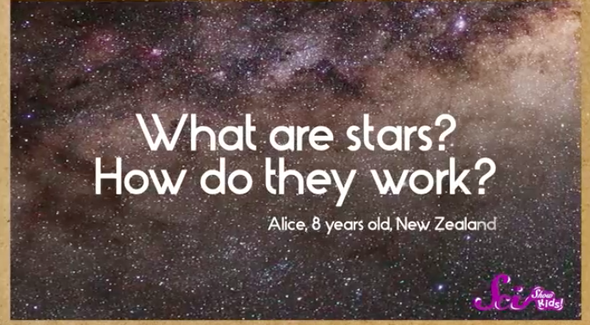
What are STARS? Click on the video below to learn more.

Slide 56
What are STARS?
STARS are luminous balls of gas in the sky, mostly made up of hydrogen and helium. Stars are held together by their own gravity. Earth’s nearest visible star is the sun.

Slide 57
Check out these photos of STARS. What do you wonder about?

Slide 58
What else are you wondering about this week? Keep track of your wonders and ideas in your STUDENT WORKBOOK.

Slide 59
Week 6 Space Exploration
Developing background knowledge.

Slide 60
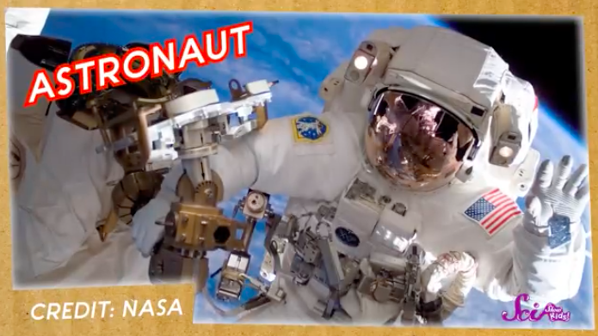
What advancements have been made in SPACE EXPLORATION? Click on the video below to learn more.

Slide 61
What advancements have been made in SPACE EXPLORATION?
SPACE EXPLORATION began October 4, 1957 when the Soviet Union launched a satellite, Sputnik 1, into space. Humans have been curious about the mysteries held in the distant sky from the beginning of time. With the launch of this first satellite, people began to slowly collect answers for their countless questions.
Click on the image to explore the
Space Exploration Timeline.

Slide 62
Check out these photos of SPACE EXPLORATION. What do you wonder about?

Slide 63
What else are you wondering about this week? Keep track of your wonders and ideas in your STUDENT WORKBOOK.

